Slide 1
Moralex Xybermedia
Articulate Presenter ’13 Demo
Notes:
Welcome to the Moralex Xybermedia Presentation. In this short presentation you will learn how to use the MM03 Display Material Tcode.

Slide 2
Introduction
In this presentation you will:
Understand the importance of Displaying Materials in SAP
Launch SAP
Access the MM03 Display Material Tcode
Navigate the different tabs

Slide 3
Importance of MM03
This Tcode is important because it allows the end user research the material and its properties before the Sales Contract creation.
The Planners can verify Quantity on Hand and pricing.
The Sales Staff can check the Mean Average Price (MAP) during the Sales Order creation.
Any Division Staff can verify the material and report its availability to other Divisions and Areas.
Notes:
*This Tcode is important because it allows the end user research the material and its properties before the Sales Contract creation.
*The Planners can verify Quantity on Hand and pricing.
*The Sales Staff can check the Mean Average Price (MAP) during the Sales Order creation.
*Any Division Staff can verify the material and report its availability to other Divisions and Areas.

Slide 4
Importance of MM03
Material Master Creation
Use MM03 to Research Material
Create Sales Contract
Notes:
The Supply Chain group creates the material in the Material Master. Then you can use the MM03 Tcode to display the material. And finally you can create the Sales Contract.

Slide 5
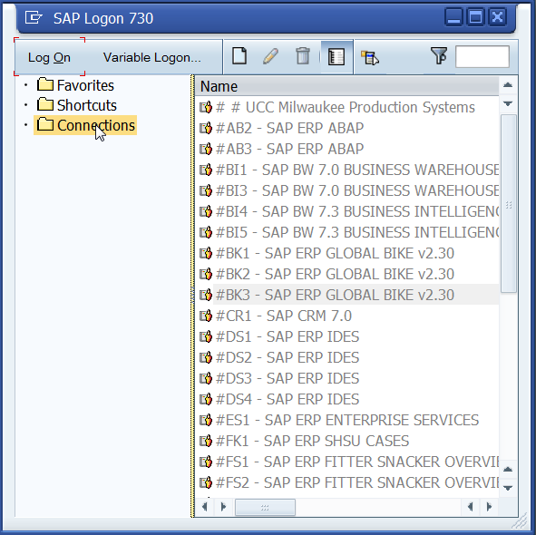
Execute MM03
Launch SAP Logon, connect to the training environment and execute the MM03 Tcode.

Slide 6
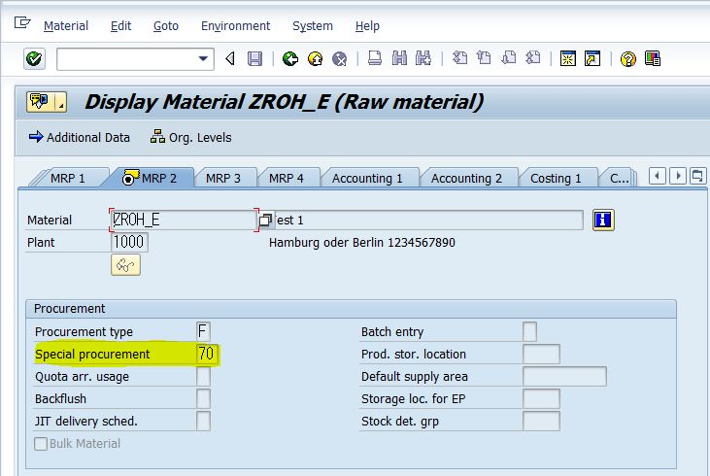
Navigate MM03 tabs

